Slide 1
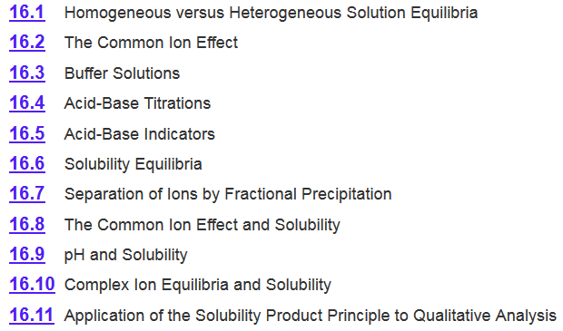
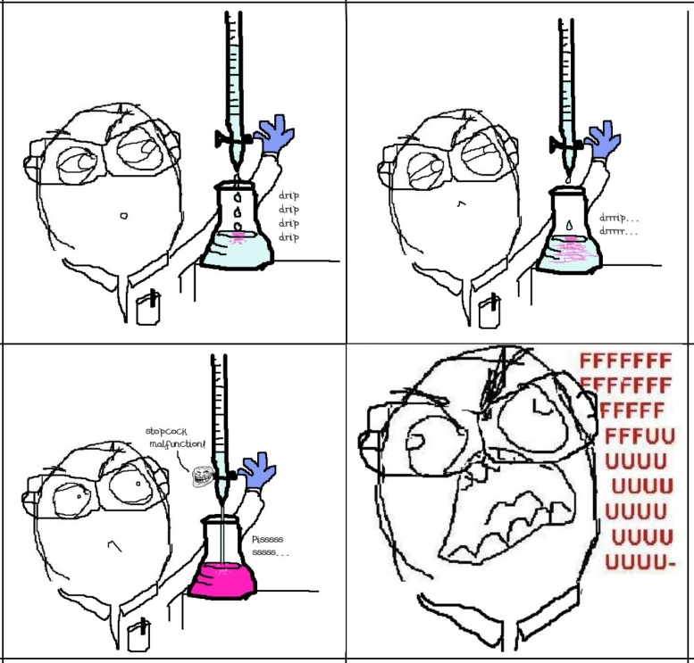
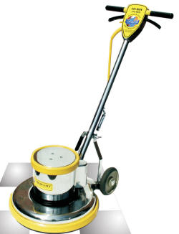
Chapter 16
Heterogeneous Equilibria

Slide 2
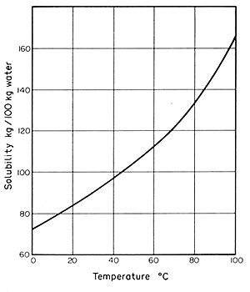
Chapter 12
The relationship between solubility and temperature can be represented by a solubility curve.
Each point in the solubility curve represents a saturated solution.
Any point below a curve represents an unsaturated solution.
Any point above the curve would be a super saturated solution.
Super saturated
Saturated
Unsaturated

Slide 3
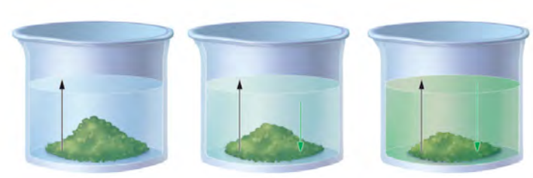
Chapter 14
The change is reversible
The system is “closed”—no substance can enter or leave
The system is dynamic - At the macroscopic level, it appears as if nothing is happening, but at the particulate level, reversible changes are occurring continuously.
Can be at physical equilibrium or chemical equilibrium
A B
Physical Equilibrium- forward and reverse processes occur at the same rate but there is no chemical change.
Solubility
At time = 0
At time > 0
At time = ∞
rate of dissolution
rate of precipitation
=

Slide 4
Chapter 16

Slide 5
Solubility
  Salts are usually strong electrolytes:
  NaCl(s) ⎯→ Na⁺(aq) + Cl–(aq)
    They dissolve in water forming hydrated ions until a saturated solution is formed.
    In the saturated solution, there exists a dynamic equilibrium between the solid salt and dissolved ions.
  Some salts, however, are only sparingly soluble:
  AgCl(s) Ag⁺(aq) + Cl–(aq)
    Only a small amount of such a salt is required to produce a saturated solution.

Slide 6
Solubility Product
  AgCl(s) Ag⁺(aq) + Cl–(aq)
At equilibrium the rate of dissolution equals the rate of precipitation and an equilibrium expression can be written:
K_{c} =
[Ag⁺][Cl⁻]
= K_{sp}
K_{sp} is the solubility product constant
    The smaller the solubility product, the less soluble is the salt.
    The larger the solubility product, the more soluble is the salt.
    If two compounds have the same ion ratio, the one with the larger K_{sp} will have the higher molar solubility.

Slide 7
Solubility Product
For a general dissolution/precipitation equilibrium such as:
A_{a}B_{b}(s) aA (aq) + bB (aq)
K_{sp} =
[A]ª
[B]^{b}
K_{sp} is the solubility product constant
AgCl (s) Ag⁺ (aq) + Cl⁻ (aq)
K_{sp} = [Ag⁺][Cl⁻]
MgF₂ (s) Mg²⁺ (aq) + 2F⁻ (aq)
K_{sp} = [Mg²⁺][F⁻]²
Ag₂CO₃ (s) 2Ag⁺ (aq) + CO₃²⁻ (aq)
K_{sp} = [Ag⁺]²[CO₃²⁻]
Ca₃(PO₄)₂ (s) 3Ca²⁺ (aq) + 2PO₄³⁻ (aq)
K_{sp} = [Ca²⁺]³[PO₄³⁻]²

Slide 8
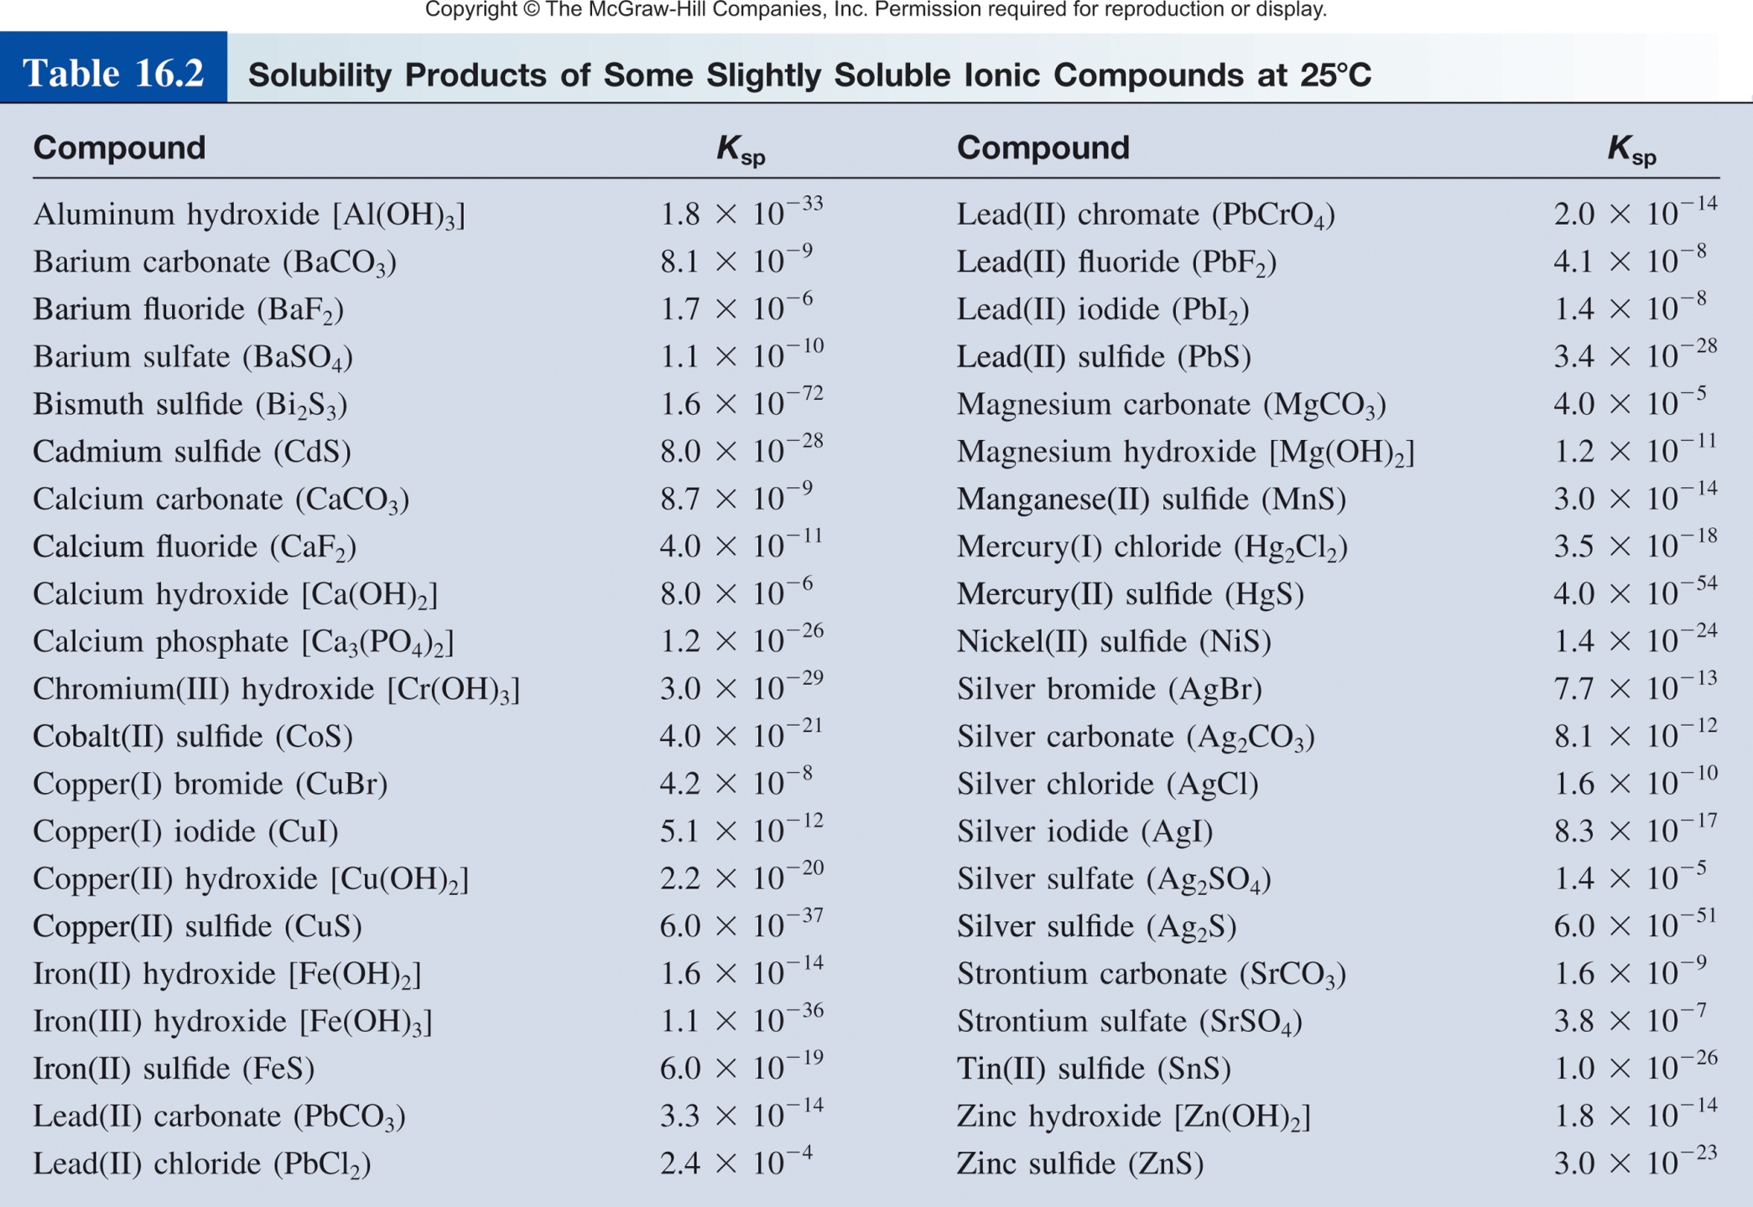
Solubility Product
Range from very small (10⁻⁷² for Bi₂S₃) to very large (NaCl).
K_{sp}
Solubility

Slide 9
Solubility
There are two other ways to express a substance’s solubility:
Molar solubility (mol/L) is the number of moles of solute dissolved in 1 L of a saturated solution.
Solubility (g/L) is the number of grams of solute dissolved in 1 L of a saturated solution.
Molar solubility
Molar solubility
Solubility
Solubility
mol
g
g
g
mol
mol
x
=
x
=
L
mol
L
L
g
L
Molar Mass
1/Molar Mass

Slide 10
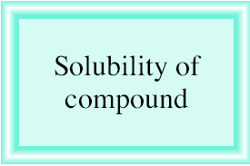
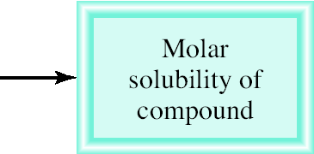
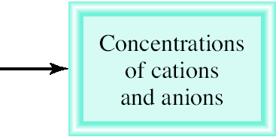
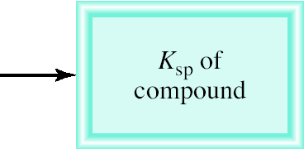
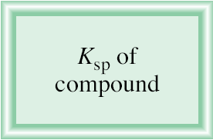
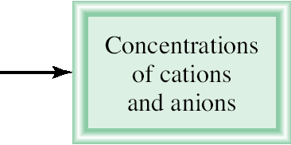
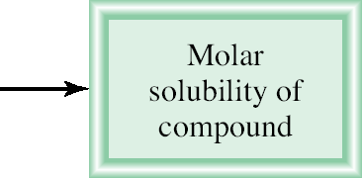
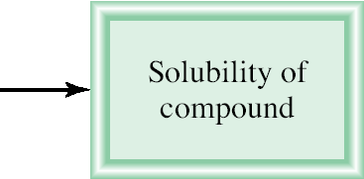
Relating Solubility Descriptions
K_{sp} is the solubility product constant
Molar solubility (mol/L)
Solubility (g/L)

Slide 11
16.8
The solubility of calcium sulfate (CaSO₄) is found to be 0.67 g/L. Calculate the value of K_{sp} for calcium sulfate.
CaSO₄(s) Ca²⁺ (aq) + SO₄²⁻ (aq)
given
?
solubility of molar solubility [Ca²⁺] and K_{sp} of
CaSO₄ in g/L of CaSO₄ [SO₄²⁻] CaSO₄
[Ca²⁺] = 4.9 x 10⁻³ M and [SO₄²⁻] = 4.9 x 10⁻³ M
K_{sp} = [Ca²⁺][SO₄²⁻]
= (4.9 x 10⁻³)(4.9 x 10⁻³) = 2.4 x 10⁻⁵

Slide 12


K_{sp} to molar solubility
K_{sp} = 7.7 x 10⁻¹³ M
K_{sp} = [Ag⁺] [Br⁻]
s = molar solubility

Slide 13
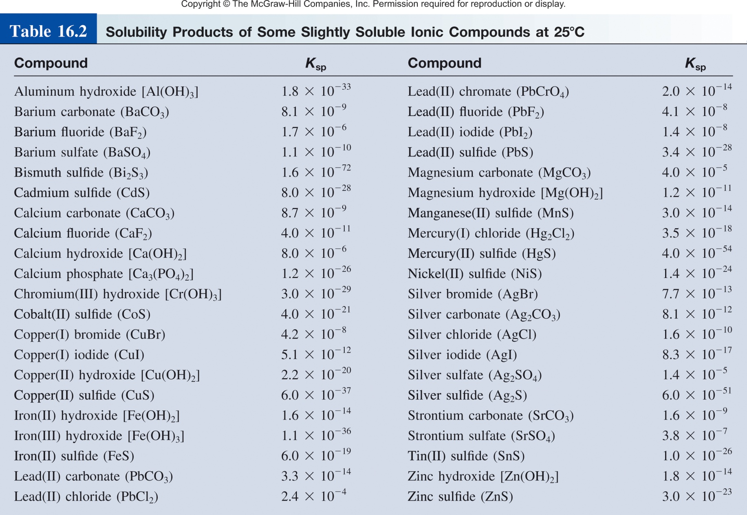
16.9
Using the data in Table 16.2, how many grams of copper(II) hydroxide, Cu(OH)₂, will dissolve in 1 L of water.

Slide 14
16.9
Using the data in Table 16.2, how many grams of copper(II) hydroxide, Cu(OH)₂, will dissolve in 1 L of water.
K_{sp} = 2.2 x 10⁻²⁰ M
K_{sp} of [Cu²⁺] and molar solubility solubility of
Cu(OH)₂ [OH⁻] of Cu(OH)₂ Cu(OH)₂ in g/L
K_{sp} = [Cu²⁺][OH⁻]²
= (s)(2s)² = 4s³
 | Cu(OH)₂(s) |  | Cu²⁺(aq) + | 2OH⁻(aq)
Initial (M): |  |  | 0 | 0
Change (M):
Equilibrium (M):
-s
+s
+2s
s
2s

Slide 15
16.9
Using the data in Table 16.2, how many grams of copper(II) hydroxide, Cu(OH)₂, will dissolve in 1 L of water.
K_{sp} = 2.2 x 10⁻²⁰ M
s = 1.8 x 10⁻⁷ M
K_{sp} of [Cu²⁺] and molar solubility solubility of
Cu(OH)₂ [OH⁻] of Cu(OH)₂ Cu(OH)₂ in g/L
K_{sp} = [Cu²⁺][OH⁻]²
= (s)(2s)² = 4s³

Slide 16
16.9
Using the data in Table 16.2, how many grams of copper(II) hydroxide, Cu(OH)₂, will dissolve in 1 L of water.
K_{sp} = 2.2 x 10⁻²⁰ M
s = 1.8 x 10⁻⁷ M
K_{sp} of [Cu²⁺] and molar solubility solubility of
Cu(OH)₂ [OH⁻] of Cu(OH)₂ Cu(OH)₂ in g/L

Slide 17
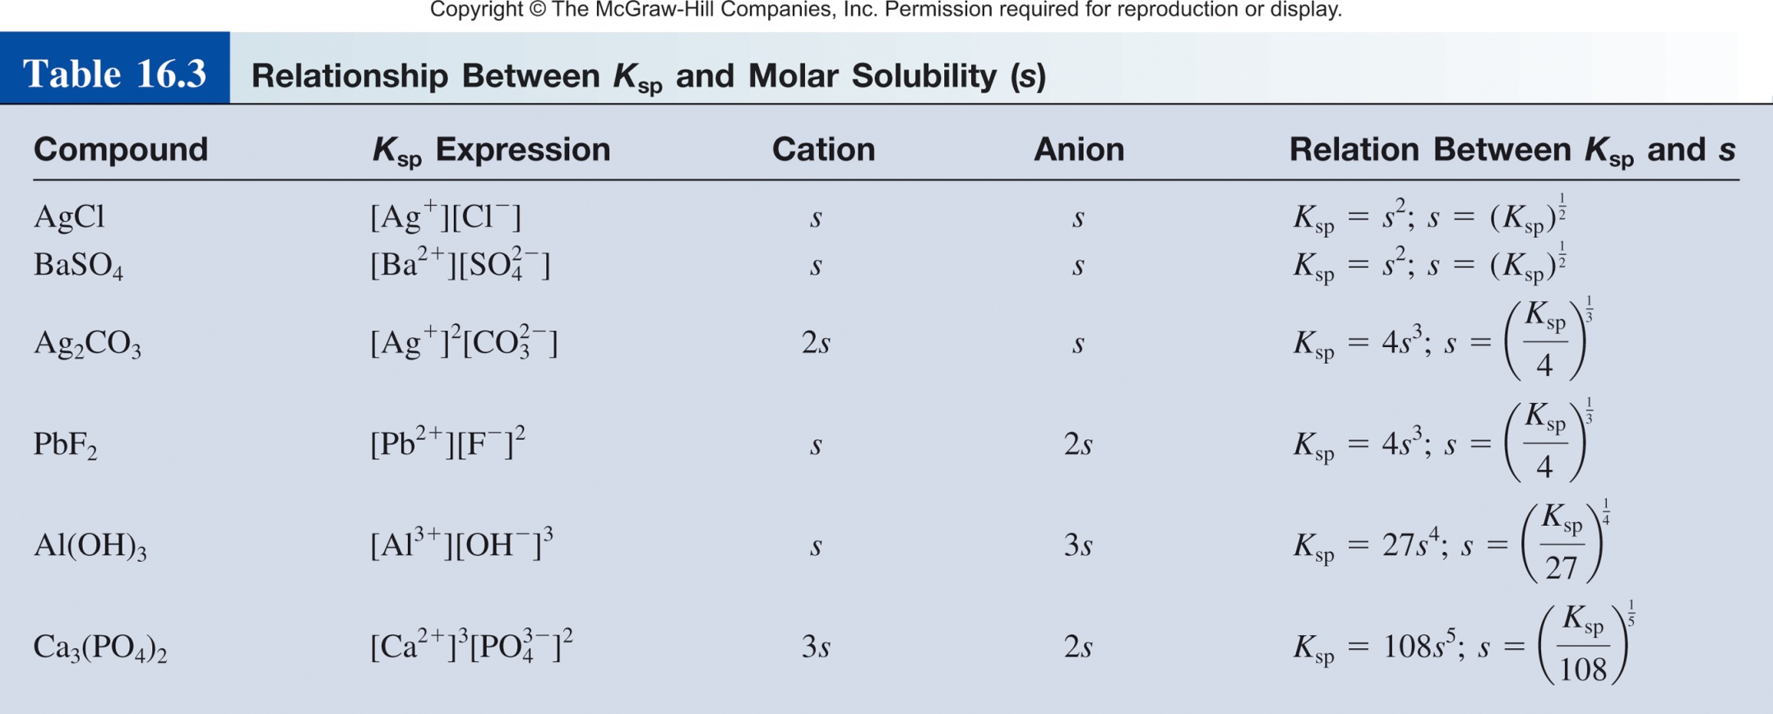
Relationship between K_{sp} and molar solubility

Slide 18
How would you solve these problems?
At 25°C, a 1 L saturated solution of silver chromate contains 0.0435 g of dissolved Ag₂CrO₄. Calculate (a) its molar solubility; (b) its solubility product constant.
Calculate the molar and mass solubilities per liter and concentrations of the constituent ions for silver chloride (K_{sp} = 1.56·10^{–10}).

Slide 19
Solubility Product
What else can we learn from K_{sp}?

Slide 20
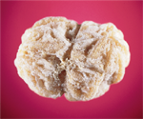
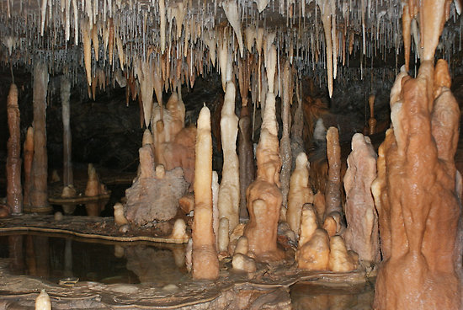
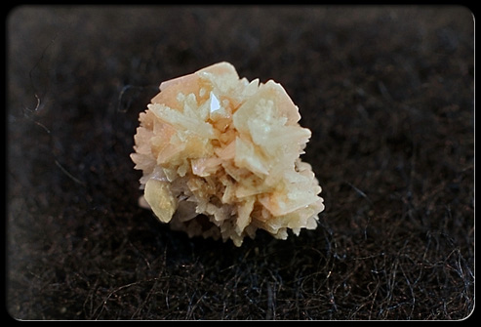
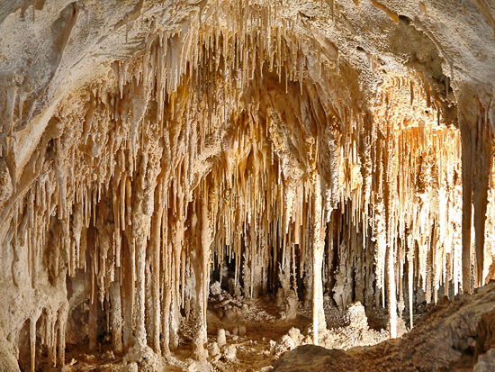
Predict Precipitation Reactions
Type of kidney stones
1.Calcium stones (80% of all kidney stones)
-Calcium oxalate (K_{sp} = 2.3 x 10⁻⁹)
-Calcium phosphate (K_{sp} = 1.2 x 10⁻²⁶)
2.Uric acid stones
3.Struvite stones (Mg²⁺, NH⁴⁺, Ca²⁺ and PO₄³⁻)

Slide 21
Predicting Precipitation Reactions
A_{a}B_{b}(s) aA (aq) + bB (aq)
The ion product Q has the same form as the equilibrium constant K.
Q is not necessarily at equilibrium, typically initial conditions.
Allows us to predict if a precipitate will form.
K_{sp} =
[A]ª
[B]^{b}
K_{sp} is the solubility product constant
Q =
[A]ª
[B]^{b}
Q is the ion product
Q < K_{sp}
Unsaturated solution
No precipitate
Q = K_{sp}
Saturated solution
Q > K_{sp}
Supersaturated solution
Precipitate will form

Slide 22
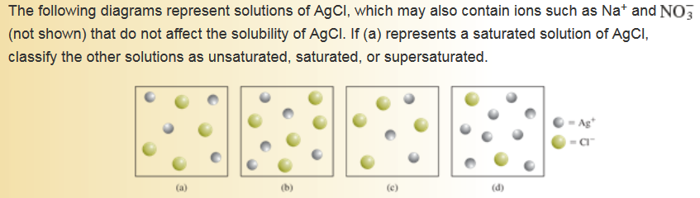
Predicting Precipitation Reactions
Q = [Ag⁺][Cl⁻]
K_{sp} = [Ag⁺][Cl⁻]
Q < K_{sp}
Unsaturated solution
Q = K_{sp}
Saturated solution
Q > K_{sp}
Supersaturated solution

Slide 23
16.10
Exactly 200 mL of 0.0040 M BaCl₂ are mixed with exactly
600 mL of 0.0080 M K₂SO₄. Will a precipitate form?
BaCl₂(s) Ba²⁺ (aq) + 2Cl⁻ (aq)
K₂SO₄(s) 2K⁺ (aq) + SO₄⁻ (aq)
200 mL of 0.004 M BaCl₂
600 mL of 0.008 M BaCl₂
Ba²⁺
K⁺
Cl⁻
Cl⁻
K⁺
SO₄⁻
Will a precipitate form?
SO₄⁻
K⁺
KCl
or
Ba(SO₄)₂
800 mL
Ba²⁺
K⁺
Cl⁻
Cl⁻

Slide 24
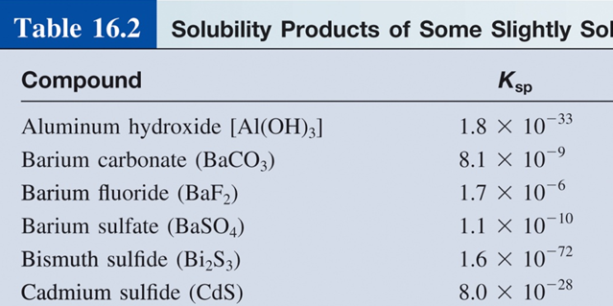
16.10
Exactly 200 mL of 0.0040 M BaCl₂ are mixed with exactly
600 mL of 0.0080 M K₂SO₄. Will a precipitate form?
Need to know K_{sp} and Q?
SO₄⁻
Q < K_{sp}
K⁺
No precipitate
Ba²⁺
Q = K_{sp}
K⁺
Cl⁻
Cl⁻
Q > K_{sp}
Precipitate will form
Ba(SO₄)₂
Ba⁺ (aq) + 2SO₄⁻ (aq)
Q = [Ba²⁺][SO₄⁻]²
Need to find

Slide 25
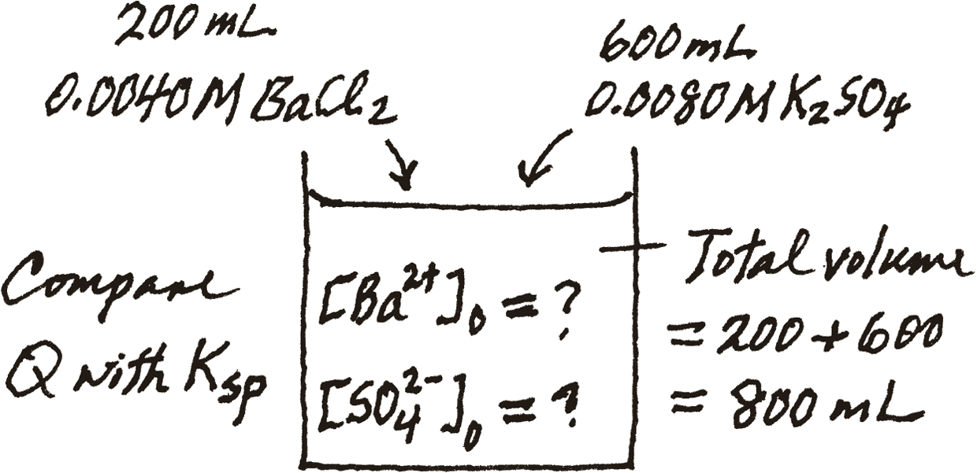
16.10
Exactly 200 mL of 0.0040 M BaCl₂ are mixed with exactly
600 mL of 0.0080 M K₂SO₄. Will a precipitate form?
Q = [Ba²⁺][SO₄⁻]²
BaCl₂(s) Ba²⁺(aq) + 2Cl⁻(aq)
K₂SO₄(s) 2K⁺(aq) + SO₄⁻(aq)
200 mL of 0.004 M BaCl₂
600 mL of 0.008 M BaCl₂

Slide 26
16.10
Exactly 200 mL of 0.0040 M BaCl₂ are mixed with exactly
600 mL of 0.0080 M K₂SO₄. Will a precipitate form?
Q = [Ba²⁺][SO₄⁻]²
BaCl₂(s) Ba²⁺(aq) + 2Cl⁻(aq)
K₂SO₄(s) 2K⁺(aq) + SO₄⁻(aq)
200 mL of 0.004 M BaCl₂
600 mL of 0.008 M BaCl₂

Slide 27
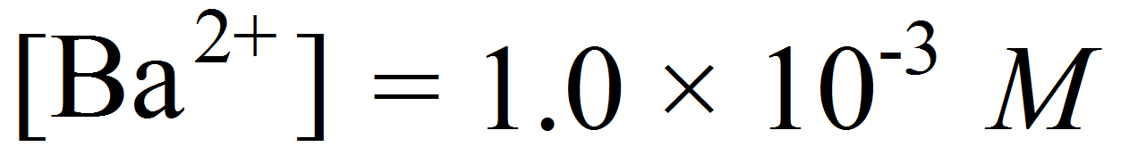
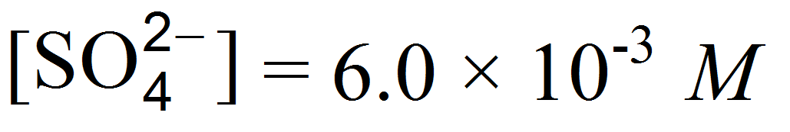
16.10
Exactly 200 mL of 0.0040 M BaCl₂ are mixed with exactly
600 mL of 0.0080 M K₂SO₄. Will a precipitate form?
Ba(SO₄)₂
Ba⁺ (aq) + 2SO₄⁻ (aq)
K_{sp} = 1.1 x 10⁻¹⁰
Q = [Ba²⁺][SO₄⁻]²
Q = (1.0 x 10⁻³)(6.0 x 10⁻³) = 6.0 x 10⁻⁶
Q > K_{sp}
Precipitate will form.

Slide 28
Chapter 16

Slide 29
Chapter 14
The change is reversible
The system is “closed”—no substance can enter or leave
The system is dynamic - At the macroscopic level, it appears as if nothing is happening, but at the particulate level, reversible changes are occurring continuously.
Can be at physical equilibrium or chemical equilibrium
A B
Physical Equilibrium- forward and reverse processes occur at the same rate but there is no chemical change.
Solubility
At time = 0
At time > 0
At time = ∞
rate of dissolution
rate of precipitation
=

Slide 30
Solubility Product
For a general dissolution/precipitation equilibrium such as:
A_{a}B_{b}(s) aA (aq) + bB (aq)
K_{sp} =
[A]ª
[B]^{b}
K_{sp} is the solubility product constant
AgCl (s) Ag⁺ (aq) + Cl⁻ (aq)
K_{sp} = [Ag⁺][Cl⁻]
MgF₂ (s) Mg²⁺ (aq) + 2F⁻ (aq)
K_{sp} = [Mg²⁺][F⁻]²
Ag₂CO₃ (s) 2Ag⁺ (aq) + CO₃²⁻ (aq)
K_{sp} = [Ag⁺]²[CO₃²⁻]
Ca₃(PO₄)₂ (s) 3Ca²⁺ (aq) + 2PO₄³⁻ (aq)
K_{sp} = [Ca²⁺]³[PO₄³⁻]²

Slide 31
Relating Solubility Descriptions
K_{sp} is the solubility product constant
Molar solubility (mol/L)
Solubility (g/L)

Slide 32
Predicting Precipitation Reactions
A_{a}B_{b}(s) aA (aq) + bB (aq)
The ion product Q has the same form as the equilibrium constant K.
Q is not necessarily at equilibrium, typically initial conditions.
Allows us to predict if a precipitate will form.
K_{sp} =
[A]ª
[B]^{b}
K_{sp} is the solubility product constant
Q =
[A]ª
[B]^{b}
Q is the ion product
Q < K_{sp}
Unsaturated solution
No precipitate
Q = K_{sp}
Saturated solution
Q > K_{sp}
Supersaturated solution
Precipitate will form

Slide 33
Chapter 16

Slide 34
Selective Precipitation
200 mL of 0.004 M BaCl₂
600 mL of 0.008 M BaCl₂
Ba²⁺
K⁺
Cl⁻
Cl⁻
K⁺
SO₄⁻
K⁺
K⁺
Cl⁻
Collect solid:
Separated some Ba⁺ and SO₄⁻
from K⁺ and Cl⁻
800 mL
Cl⁻
Ba(SO₄)₂
Separation of Ions by Fractional Precipitation.

Slide 35
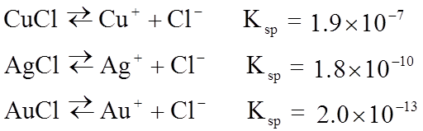
Fractional Precipitation
We can calculate the concentration of Cl⁻ required to initiate precipitation of each of these metal chlorides.
[Cl-] needed to precipitate
>1.9 x 10⁻⁵ M
Cu⁺
Ag⁺
>1.8 x 10⁻⁸ M
Au⁺
SO₄²⁻
>2.0 x 10⁻¹¹ M
0.010 M M⁺
We need to add a minimum of 1.9 x 10⁻⁵ M Cl⁻ to begin to precipitate Cu⁺.

Slide 36
Fractional Precipitation
We can calculate the concentration of Cl⁻ required to initiate precipitation of each of these metal chlorides.
[Cl-] needed to precipitate
>1.9 x 10⁻⁵ M
Cu⁺
Ag⁺
>1.8 x 10⁻⁸ M
Au⁺
SO₄²⁻
>2.0 x 10⁻¹¹ M
0.010 M M⁺
What is the maximum Au⁺ we can precipitate without precipitating any Ag⁺?
Max amount of Cl⁻ we can add before Ag⁺ precipitates.

Slide 37
Fractional Precipitation
We can calculate the concentration of Cl⁻ required to initiate precipitation of each of these metal chlorides.
[Cl-] needed to precipitate
>2.0 x 10⁻¹¹ M
Cu⁺
Ag⁺
>1.8 x 10⁻⁸ M
Au⁺
SO₄²⁻
>1.9 x 10⁻⁵ M
0.010 M M⁺
What is the maximum Au⁺ we can precipitate without precipitating any Ag⁺?
Therefore, 99.99989% of the Au⁺ ions precipitates before AgCl begins to precipitate.

Slide 38
16.11
A solution contains 0.020 M Cl⁻ ions and 0.020 M Br⁻ ions. To separate the Cl⁻ ions from the Br⁻ ions, solid AgNO₃ is slowly added to the solution without changing the volume. What concentration of Ag⁺ ions (in mol/L) is needed to precipitate as much AgBr as possible without precipitating AgCl?
AgBr(s) Ag⁺(aq) + Br⁻(aq)
K_{sp} = [Ag⁺][Br⁻] = 7.7 x 10⁻³
AgCl(s) Ag⁺(aq) + Cl⁻(aq)
K_{sp} = [Ag⁺][Cl⁻] = 1.6 x 10⁻¹⁰
To precipitate the Br⁻ ions as AgBr without precipitating the Cl⁻ ions as AgCl, then, [Ag⁺] must be lower than 8.0 x 10⁻⁹ M.

Slide 39
Chapter 16

Slide 40
Common Ion Effect and pH
The common ion effect is the shift in equilibrium caused by the addition of a compound having an ion in common with the dissolved substance.
Specific case of LCP
CH₃COOH (aq) H⁺ (aq) + CH₃COO⁻ (aq)
Then we add some CH₃COONa (a strong electrolyte).
common ion
CH₃COONa (s) Na⁺ (aq) + CH₃COO⁻(aq)
The presence of a common ion suppresses the ionization of a weak acid or a weak base. It will influence the pH.

Slide 41

Common Ion Effect and Solubility
The common ion effect is the shift in equilibrium caused by the addition of a compound having an ion in common with the dissolved substance.
Specific case of LCP
common ion
Add AgNO₃
Cl⁻
Ag⁺
Ag⁺
Cl⁻
AgCl
More precipitate will form as we add AgNO₃.
The presence of a common ion decreases the solubility of the salt.

Slide 42
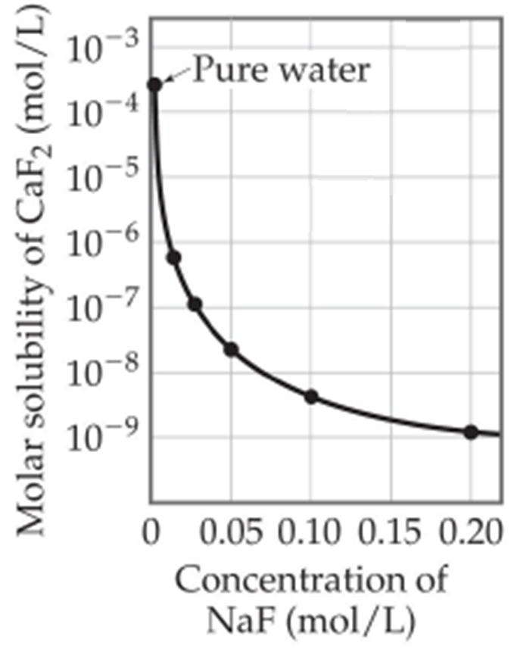
Common Ion Effect and Solubility
The common ion effect is the shift in equilibrium caused by the addition of a compound having an ion in common with the dissolved substance.
Specific case of LCP
Add NaF
CaF₂(s) Ca²⁺(aq) + F⁻(aq)
F⁻
Ca²⁺
NaF (s) Na⁺(aq) + F⁻(aq)
Ca²⁺
F⁻
CaF₂

Slide 43
Common Ion Effect and Solubility
The common ion effect is the shift in equilibrium caused by the addition of a compound having an ion in common with the dissolved substance.
Specific case of LCP
Add NaF
CaF₂(s) Ca²⁺(aq) + F⁻(aq)
F⁻
Ca²⁺
NaF (s) Na⁺(aq) + F⁻(aq)
Ca²⁺
F⁻
CaF₂
Salts become increasingly less soluble when more common ion is added.

Slide 44
16.12
Calculate the solubility of silver chloride (in g/L) in a 6.5 x 10⁻³ M silver nitrate solution. (AgCl, K_{sp} = 1.6 x 10⁻¹⁰)
First lets calculate the solubility of AgCl (in g/L):
K_{sp} of [Ag⁺] and molar solubility solubility of
AgCl [Cl⁻] of AgCl AgCl in g/L
K_{sp} = [Ag⁺][Cl⁻]
= (s)(s) = s²
= 1.6 x 10⁻¹⁰
 | AgCl(s) |  | Ag⁺(aq) + | Cl⁻(aq)
Initial (M): |  |  | 0 | 0
Change (M):
Equilibrium (M):
-s
+s
+s
s
s
K_{sp} = 1.6 x 10⁻¹⁰
s = 1.3 x 10⁻⁶ mol/L

Slide 45
16.12
Calculate the solubility of silver chloride (in g/L) in a 6.5 x 10⁻³ M silver nitrate solution. (AgCl, K_{sp} = 1.6 x 10⁻¹⁰)
First lets calculate the solubility of AgCl (in g/L):
K_{sp} of [Ag⁺] and molar solubility solubility of
AgCl [Cl⁻] of AgCl AgCl in g/L
1.3 x 10⁻⁶ mol/L
143.4 g/mol
1.8 x 10⁻³ g/L

Slide 46
16.12
Calculate the solubility of silver chloride (in g/L) in a 6.5 x 10⁻³ M silver nitrate solution. (AgCl, K_{sp} = 1.6 x 10⁻¹⁰)
First lets calculate the solubility of AgCl (in g/L):
1.8 x 10⁻³ g/L
What happens to this number is we are in a 6.5 x 10⁻³ M silver nitrate solution.
Solubility of AgCl will go down.
< 1.8 x 10⁻³ g/L
common ion

Slide 47
16.12
Calculate the solubility of silver chloride (in g/L) in a 6.5 x 10⁻³ M silver nitrate solution. (AgCl, K_{sp} = 1.6 x 10⁻¹⁰)
First lets calculate the solubility of AgCl (in g/L):
1.8 x 10⁻³ g/L
What happens to this number is we are in a 6.5 x 10⁻³ M silver nitrate solution.
6.5 x 10⁻³ M
6.5 x 10⁻³ M
 | AgCl(s) |  | Ag⁺(aq) + | Cl⁻(aq)
Initial (M):
Change (M):
Equilibrium (M):
6.5 x 10⁻³
0.00
-s
+s
+s
(6.5 x 10⁻³ +s)
s
K_{sp} = [Ag⁺][Cl⁻]
1.6 x 10⁻¹⁰ = (6.5 x 10⁻³ + s)(s)
s = 2.5 x 10⁻⁸ M

Slide 48
16.12
Calculate the solubility of silver chloride (in g/L) in a 6.5 x 10⁻³ M silver nitrate solution. (AgCl, K_{sp} = 1.6 x 10⁻¹⁰)
First lets calculate the solubility of AgCl (in g/L):
1.8 x 10⁻³ g/L
What happens to this number is we are in a 6.5 x 10⁻³ M silver nitrate solution.
molar solubility solubility of
of AgCl AgCl in g/L
2.5 x 10⁻⁸ M
143.4 g/mol
3.6 x 10⁻³ g/L
AgCl becomes less soluble when Ag⁺ is added.

Slide 49
Chapter 16

Slide 50
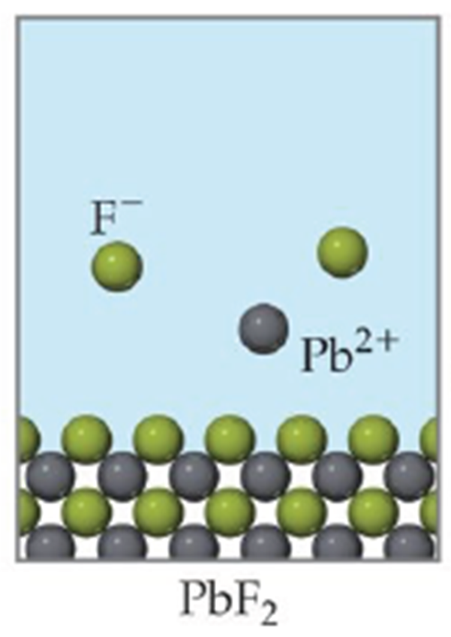
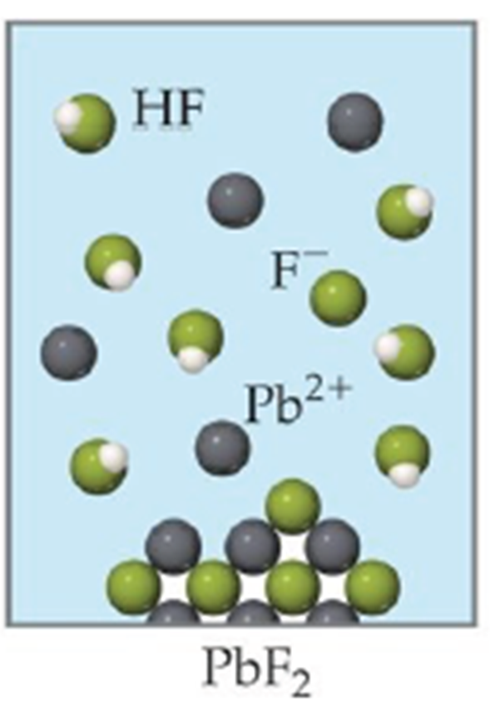
pH and Solubility
The solubility of salts that generate acidic or basic ions is influenced by the pH of the solution.
Insoluble bases dissolve in acidic solutions
Insoluble acids dissolve in basic solutions
PbF₂(s) Pb²⁺ (aq) + 2F⁻ (aq)
Add H⁺
HF(aq) H⁺ (aq) + F⁻ (aq)
Decreases

Slide 51
16.13
Which of the following compounds will be more soluble in acidic solution (H⁺) than in water:
CuS
More soluble in acid.
CuS(s) Cu²⁺(aq) + S²⁻(aq)
S²⁻(aq) + H⁺(aq) HS⁻(aq)
Decreases
(b) AgCl
Does not change.
Cl⁻ is a conjugate base of HCl.
Cl⁻ is a very weak base.
AgCl(s) Ag⁺(aq) + Cl⁻(aq)
(c) PbSO₄
More soluble in acid.
PbSO₄(s) Pb²⁺(aq) + SO₄²⁻ (aq)
SO₄²⁻(aq) + H⁺(aq) HSO₄⁻(aq)
Decreases

Slide 52
pH and Solubility
Mg(OH)₂ (s) Mg²⁺ (aq) + 2OH⁻ (aq)
Add H⁺, more soluble.
Add OH⁻, less soluble.
K_{sp} = [Mg²⁺][OH⁻]² = 1.2 x 10⁻¹¹
At pH less than 10.45
K_{sp} = (s)(2s)² = 4s³
Decrease [OH⁻], shift right
Increase solubility of Mg(OH)₂
4s³ = 1.2 x 10⁻¹¹
s = 1.4 x 10⁻⁴ M
At pH greater than 10.45
[OH⁻] = 2s = 2.8 x 10⁻⁴ M
Increase [OH⁻], shift left
pOH = 3.55 pH = 10.45
Decrease solubility of Mg(OH)₂

Slide 53
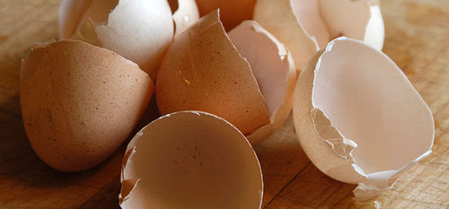
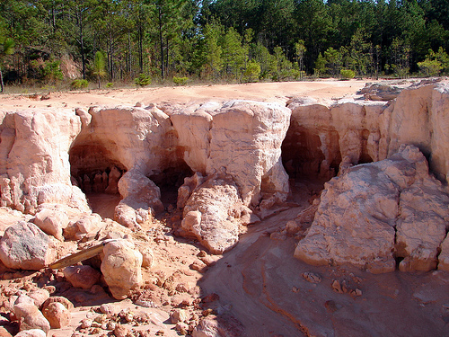
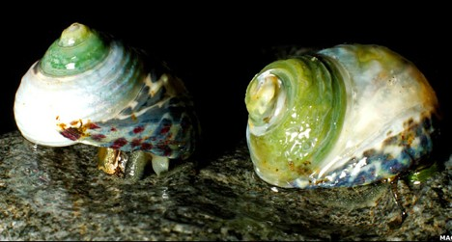
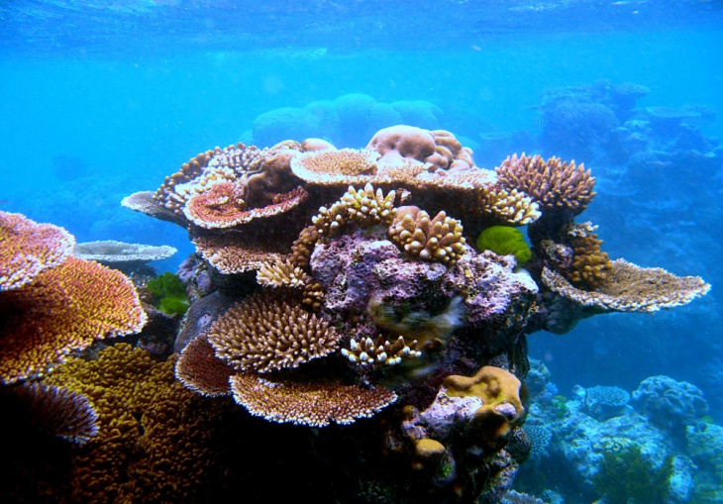
pH and Solubility
Calcium carbonate (CaCO₃)
Egg Shells
Limestone
Sea Shells
Coral Reef

Slide 54
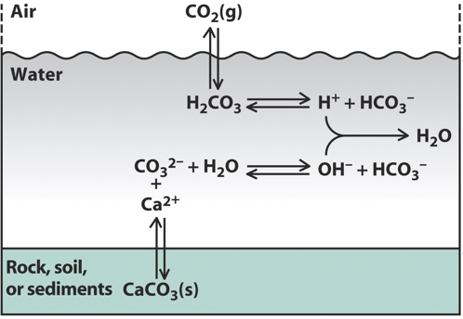
pH and Solubility
Increasing atmospheric CO₂
Increasing atmospheric CO₂ → Ocean acidification → Dissolves CaCO₃

Slide 55
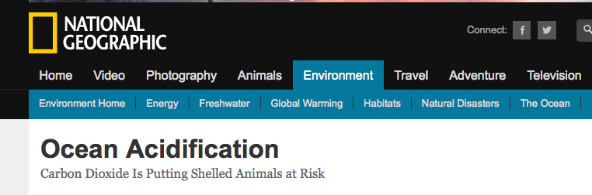
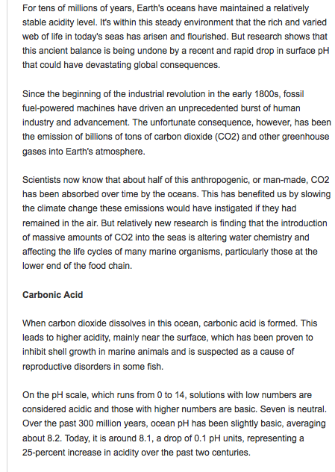
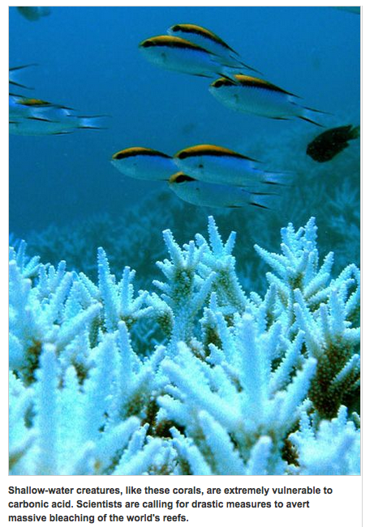
http://ocean.nationalgeographic.com/ocean/critical-issues-ocean-acidification/

Slide 56
pH and Solubility
Calcium carbonate (CaCO₃)
Egg Shells
Limestone
Sea Shells
Coral Reef

Slide 57
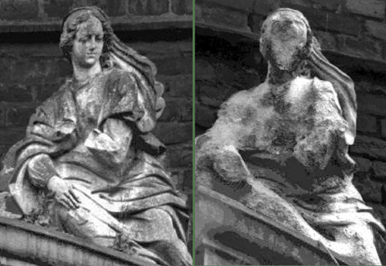
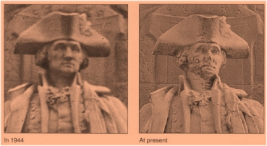
pH and Solubility
Limestone
CaCO₃ becomes increasingly soluble when H⁺ is added (acid rain, ocean acidification).
60 years
60 years

Slide 58
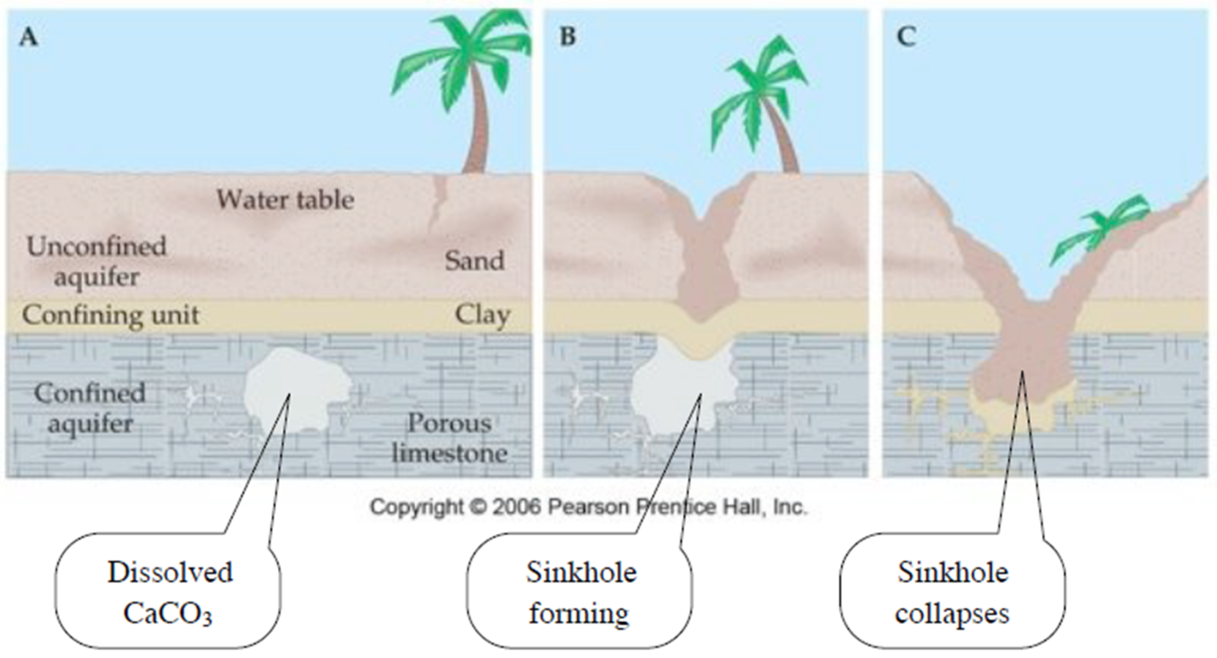
pH and Solubility

Slide 59
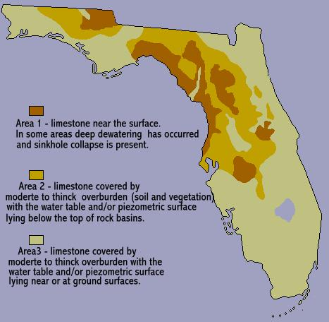
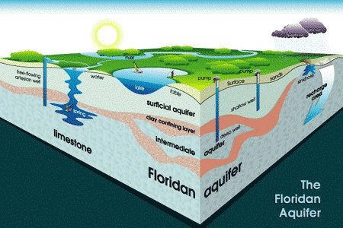
pH and Solubility

Slide 60
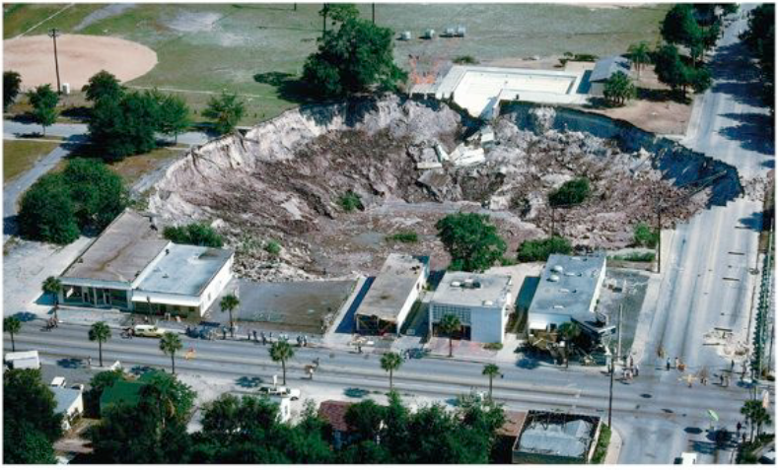

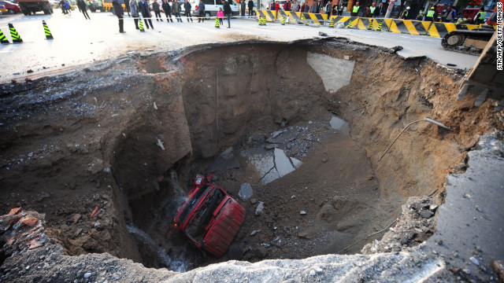
Testable Hypothesis
Climate Change:
Increased acidity
Disrupted Water Cycle

Slide 61
Chapter 16

Slide 62
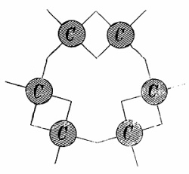
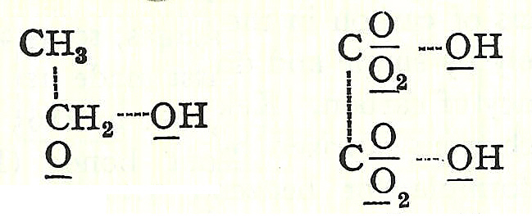
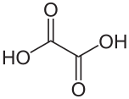

Organic Bonding Lewis Dot Strucutres
1857- Kekule proposes the correct structure of benzene.
1856- Couper proposed that atoms joined to each other like modern-day Tinkertoys.
Ethanol
Oxalic acid

Slide 63
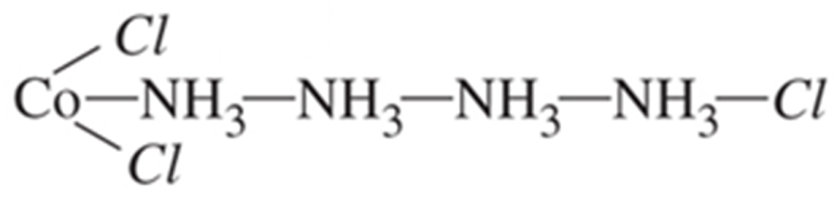
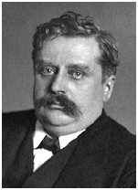

Inorganic Complexes
Co³⁺ + 4 x NH₃ + 3 x Cl
      Late 1800s- Blomstrand and Jorgenson
Proposed structure:
      1893- Werner’s Theory
      Werner was awarded the Nobel Prize in 1913
      (only inorg. up until 1973)
      Lewis acid-base
      coordination complex
Notes:
Precipitation and conductance

Slide 64
Lewis Acids and Bases
  A base is any species that donates an electron pair.
  An acid is any species that accepts an electron pair.
  This definition greatly expands the classes of acids.
  The acid-base reaction, in the Lewis sense, is the sharing of an electron pair between an acid and a base resulting in the formation of a bond:
  A + :B ⎯→ A–B
H
H
M
+
•
N H
M
N H
•
H
H
acid
base
No H⁺ or OH⁻ created. No protons donated or accepted!

Slide 65
Complex Ion
Many metal ions (Lewis acid), especially transition metals, form coordinate covalent bonds with molecules or anions having a lone pair of electrons (Lewis base).
M
+
L
A complex ion is an ion containing a central metal cation bonded to one or more molecules or ions. Also known as a coordination complex.
  The Lewis base (electron pair donor) that bonds to a metal ion to form a complex ion is also known as a Ligand.

Slide 66
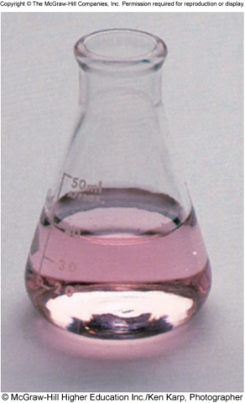

Complex Ion Equilibria
Formation constant (K_{f}), also known as the stability constant, is the equilibrium constant for the formation of a complex ion
Lewis acid
Complex Ion
2-
Co²⁺ (aq) + 4Cl⁻ (aq) CoCl₄ (aq)
Lewis base
Soluble
2+
Co(H₂O)₆
2-
CoCl₄
2-
[CoCl₄ ]
K_{f} =
[Co²⁺][Cl⁻]⁴
HCl
stability of complex
K_{f}

Slide 67

Complex Ion Equilibria
Complex Ion
Lewis acid
Lewis base

Slide 68
Complex Ion Equilibria
The formation constant (K_{f} ) is the equilibrium constant for the formation of a complex ion.
Lewis acid
Complex Ion
Ag⁺(aq) + 2NH₃(aq) Ag(NH₃)₂⁺(aq)
Lewis base
K_{f} = 1.5 x 10⁷
The dissociation constant (K_{d}) is the equilibrium constant for the dissociation of the complex (K_{d} = 1/K_{f} ).
Ag(NH₃)₂⁺(aq) Ag⁺(aq) + 2NH₃(aq)
K_{d} = 6.7 x 10⁻⁸

Slide 69


16.15
A 0.20-mole quantity of CuSO₄ is added to a liter of 1.20 M NH₃ solution. What is the concentration of Cu²⁺ ions at equilibrium?
CuSO₄(aq) Cu²⁺(aq) + SO₄²⁻(aq)
0.2 M
0.2 M
Cu²⁺(aq) + 4NH₃(aq) Cu(NH₃)₄²⁺(aq)
K_{f} = 5.0 x 10¹³
 | [Cu²⁺] | [NH₃] | [Cu(NH₃)₂²⁺]
Initial
Change
Equilibrium
0.2
1.2
0
-≈0.2
-4(0.2)
+0.2
x
0.4
0.2
x = [Cu²⁺] = 1.6 x 10⁻¹³ M

Slide 70




K_{sp} and K_{f}
K_{sp} = 1.6 x 10⁻¹⁰
1/K_{sp} = 1/7.7 x 10⁻³
  AgCl(s) Ag⁺(aq) + Cl–(aq)
  Ag⁺(aq) + Br–(aq) AgBr(s)
  Ag⁺(aq) + NH₃(aq) Ag(NH₃)₂⁺(aq)
  Ag⁺(aq) + S₂O₃²⁻(aq) Ag(S₂O₃)₂²⁻(aq)
K_{f} = 1.7 x 10⁷
K_{f} = 1.7 × 10¹³

Slide 71
Chapter 16

Slide 72
Solubility Product
For a general dissolution/precipitation equilibrium such as:
A_{a}B_{b}(s) aA (aq) + bB (aq)
K_{sp} =
[A]ª
[B]^{b}
K_{sp} is the solubility product constant
AgCl (s) Ag⁺ (aq) + Cl⁻ (aq)
K_{sp} = [Ag⁺][Cl⁻]
MgF₂ (s) Mg²⁺ (aq) + 2F⁻ (aq)
K_{sp} = [Mg²⁺][F⁻]²
Ag₂CO₃ (s) 2Ag⁺ (aq) + CO₃²⁻ (aq)
K_{sp} = [Ag⁺]²[CO₃²⁻]
Ca₃(PO₄)₂ (s) 3Ca²⁺ (aq) + 2PO₄³⁻ (aq)
K_{sp} = [Ca²⁺]³[PO₄³⁻]²

Slide 73
Relating Solubility Descriptions
K_{sp} is the solubility product constant
Molar solubility (mol/L)
Solubility (g/L)

Slide 74
Predicting Precipitation Reactions
A_{a}B_{b}(s) aA (aq) + bB (aq)
The ion product Q has the same form as the equilibrium constant K.
Q is not necessarily at equilibrium, typically initial conditions.
Allows us to predict if a precipitate will form.
K_{sp} =
[A]ª
[B]^{b}
K_{sp} is the solubility product constant
Q =
[A]ª
[B]^{b}
Q is the ion product
Q < K_{sp}
Unsaturated solution
No precipitate
Q = K_{sp}
Saturated solution
Q > K_{sp}
Supersaturated solution
Precipitate will form

Slide 75
Chapter 16

Slide 76
Fractional Precipitation
We can calculate the concentration of Cl⁻ required to initiate precipitation of each of these metal chlorides.
[Cl-] needed to precipitate
>1.9 x 10⁻⁵ M
Cu⁺
Ag⁺
>1.8 x 10⁻⁸ M
Au⁺
SO₄²⁻
>2.0 x 10⁻¹¹ M
0.010 M M⁺
What is the maximum Au⁺ we can precipitate without precipitating any Ag⁺?
Max amount of Cl⁻ we can add before Ag⁺ precipitates.

Slide 77
Chapter 16

Slide 78
Common Ion Effect and Solubility
The common ion effect is the shift in equilibrium caused by the addition of a compound having an ion in common with the dissolved substance.
Specific case of LCP
common ion
Add AgNO₃
Cl⁻
Ag⁺
Ag⁺
Cl⁻
AgCl
More precipitate will form as we add AgNO₃.
The presence of a common ion decreases the solubility of the salt.

Slide 79
Chapter 16

Slide 80
pH and Solubility
The solubility of salts that generate acidic or basic ions is influenced by the pH of the solution.
Insoluble bases dissolve in acidic solutions
Insoluble acids dissolve in basic solutions
PbF₂(s) Pb²⁺ (aq) + 2F⁻ (aq)
Add H⁺
HF(aq) H⁺ (aq) + F⁻ (aq)
Decreases

Slide 81
pH and Solubility
Mg(OH)₂ (s) Mg²⁺ (aq) + 2OH⁻ (aq)
Add H⁺, more soluble.
Add OH⁻, less soluble.
K_{sp} = [Mg²⁺][OH⁻]² = 1.2 x 10⁻¹¹
At pH less than 10.45
K_{sp} = (s)(2s)² = 4s³
Decrease [OH⁻], shift right
Increase solubility of Mg(OH)₂
4s³ = 1.2 x 10⁻¹¹
s = 1.4 x 10⁻⁴ M
At pH greater than 10.45
[OH⁻] = 2s = 2.8 x 10⁻⁴ M
Increase [OH⁻], shift left
pOH = 3.55 pH = 10.45
Decrease solubility of Mg(OH)₂

Slide 82
pH and Solubility
Limestone
CaCO₃ becomes increasingly soluble when H⁺ is added (acid rain, ocean acidification).
60 years
60 years

Slide 83
pH and Solubility

Slide 84
Chapter 16

Slide 85
Complex Ion
Many metal ions (Lewis acid), especially transition metals, form coordinate covalent bonds with molecules or anions having a lone pair of electrons (Lewis base).
M
+
L
Soluble
A complex ion is an ion containing a central metal cation bonded to one or more molecules or ions. Also known as a coordination complex.
  The Lewis base (electron pair donor) that bonds to a metal ion to form a complex ion is also known as a Ligand.
Lewis acid
Complex Ion
2-
Co²⁺ (aq) + 4Cl⁻ (aq) CoCl₄ (aq)
Lewis base
Ligand

Slide 86
Complex Ion Equilibria
The formation constant (K_{f} ) is the equilibrium constant for the formation of a complex ion.
Lewis acid
Complex Ion
Ag⁺(aq) + 2NH₃(aq) Ag(NH₃)₂⁺(aq)
Lewis base
K_{f} = 1.5 x 10⁷
The dissociation constant (K_{d}) is the equilibrium constant for the dissociation of the complex (K_{d} = 1/K_{f} ).
Ag(NH₃)₂⁺(aq) Ag⁺(aq) + 2NH₃(aq)
K_{d} = 6.7 x 10⁻⁸

Slide 87
Complex Ion Equilibria
Complex Ion
Lewis acid
Lewis base

Slide 88
K_{sp} and K_{f}
K_{sp} = 1.6 x 10⁻¹⁰
1/K_{sp} = 1/7.7 x 10⁻³
  AgCl(s) Ag⁺(aq) + Cl–(aq)
  Ag⁺(aq) + Br–(aq) AgBr(s)
  Ag⁺(aq) + NH₃(aq) Ag(NH₃)₂⁺(aq)
  Ag⁺(aq) + S₂O₃²⁻(aq) Ag(S₂O₃)₂²⁻(aq)
K_{f} = 1.7 x 10⁷
K_{f} = 1.7 × 10¹³

Slide 89

K_{sp} and K_{f}

Slide 90
Chapter 14: Multiple Equilibria
Product molecules of one equilibrium constant are involved in a second equilibrium process.
‘
[C][D]
A + B C + D
K_{c}
‘
K_{c} =
[A][B]
C + D E + F
‘
‘
K_{c}
[E][F]
‘
‘
A + B E + F
K_{c}
K_{c} =
[C][D]
[C][D]
[E][F]
[E][F]
‘
‘
K_{c}
‘
x
K_{c} =
K_{c} =
x
K_{c}
=
[A][B]
[C][D]
[A][B]
If a reaction can be expressed as the sum of two or more reactions, the equilibrium constant for the overall reaction is given by the product of the equilibrium constants of the individual reactions.

Slide 91

K_{sp} and K_{f}
AgCl_{(s)} ←→ Ag⁺ + Cl⁻ K_{sp}
Ag⁺ + 2NH₃ ←→ Ag(NH₃)₂⁺ K_{f}
AgCl + 2NH₃ ←→ Ag(NH₃)₂⁺ + Cl⁻ K = K_{sp} x K_{f}

Slide 92

16.16
Calculate the molar solubility of AgCl in a 1.0 M NH₃ solution.
[Cl⁻] = molar solubility of AgCl
AgCl_{(s)} ←→ Ag⁺ + Cl⁻
Ag⁺ + 2NH₃ ←→ Ag(NH₃)₂⁺
AgCl + 2NH₃ ←→ Ag(NH₃)₂ + Cl⁻
K_{sp} = 1.82 x 10⁻¹⁰
K_{f} = 1.7 x 10⁷
K = K_{sp} x K_{f}

Slide 93
16.16
Calculate the molar solubility of AgCl in a 1.0 M NH₃ solution.
K = 2.4 x 10⁻³
[Cl⁻] = molar solubility of AgCl
 | AgCl(s) | + 2NH₃(aq) |  | (aq) | + Cl-(aq)
Initial (M):
Change (M):
Equilibrium (M):
1.0
0.0
0.0
-s
-2s
+s
+s
1.0 – 2s
s
s

Slide 94




K_{sp} and K_{f}
AgNO₃ + NaCl
Add NH₃
AgCl
Ag(NH₃)₂⁺

Slide 95





K_{sp}, K_{f} and Photography

Slide 96




K_{sp}, K_{f} and Photography
      AgBr Gel
      Unless you processes it the material will continue to turn black.
AgBr(s) AgBr*(s) + Ag(s)
colorless
black

Slide 97

K_{sp}, K_{f} and Photography
The developer converts the latent image to macroscopic particles of metallic silver.
A stop bath, typically a dilute solution of acetic acid or citric acid, halts the action of the developer. A rinse with clean water may be substituted.
The fixer makes the image permanent and light-resistant by dissolving remaining silver halide. A common fixer is hypo, specifically ammonium thiosulfate.
Washing in clean water removes any remaining fixer. Residual fixer can corrode the silver image, leading to discolouration, staining and fading.

Slide 98

K_{sp}, K_{f} and Photography
The developer converts the latent image to macroscopic particles of metallic silver.
In the Devloper solution.
AgBr(s) AgBr*(s) + Ag(s)
colorless
black
Redox Chemistry.

Slide 99

K_{sp}, K_{f} and Photography
A stop bath, typically a dilute solution of acetic acid or citric acid [H⁺], halts the action of the developer. A rinse with clean water may be substituted.
After the stop bath.
Ag(s)
AgBr(s)
Use LCP to STOP the reaction
(shift the reaction left).

Slide 100
K_{sp}, K_{f} and Photography
A stop bath, typically a dilute solution of acetic acid or citric acid [H⁺], halts the action of the developer. A rinse with clean water may be substituted.
After the stop bath.
Ag(s) = completely insoluble.
Ag(s)
Under normal conditions.
AgBr(s) Ag⁺(aq) + Br⁻(s)
AgBr(s)
K_{sp} = 5.0 x 10⁻¹³
Wash with gallons and gallons of water to remove AgBr and not Ag. Or…

Slide 101
K_{sp}, K_{f} and Photography
The fixer makes the image permanent and light-resistant by dissolving remaining silver halide. A common fixer is hypo, specifically ammonium thiosulfate.
AgBr(s) Ag⁺(aq) + Br⁻(s)
Ag(s) = completely insoluble.
Under normal conditions.
AgBr(s) Ag⁺(aq) + Br⁻(s)
  Ag⁺(aq) + S₂O₃²⁻(aq) Ag(S₂O₃)₂²⁻(aq)
K_{sp} = 5.0 x 10⁻¹³
Decreases
K_{f} = 1.7 x 10¹³
Wash with gallons and gallons of water to remove AgBr and not Ag. Or…
In the fixer solution.

Slide 102



K_{sp}, K_{f} and Photography
Washing in clean water removes any remaining fixer. Residual fixer can corrode the silver image, leading to discolouration, staining and fading.

Slide 103



K_{sp}, K_{f} and Photography
CCD and CMOS detectors.

Slide 104
Chapter 16

Slide 105
Qualitative Analysis
Qualitative analysis- the determination of the elements/ions present in a sample.
Production quality
Environmental chemistry
Food quality
Medicine/toxicology
Forensics
Archeology/geology/palentology
Appearance of the substance
Heating effects
Flame test
Solubility
Reaction with acids/bases
Reaction with silver nitrate

Slide 106








Qualitative Analysis: Flame Test
Atomic emission spectroscopy
Hydrogen Sample
H*
H*
H*
H*
H*
H*
H*
Prism
Line Spectrum
lithium
sodium
potassium
copper

Slide 107

Qualitative Analysis: Solubility

Slide 108









Qualitative Analysis: Solubility

Slide 109
Chapter 16

